Slide 1


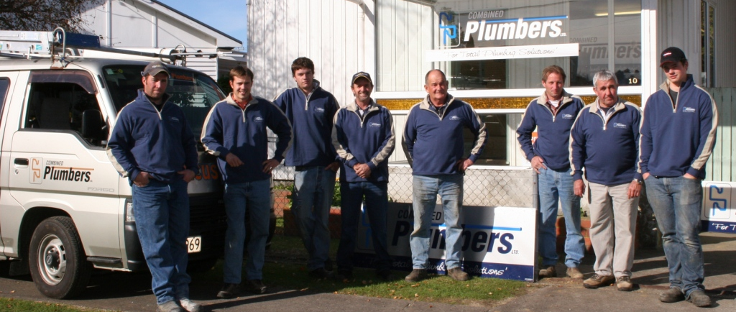


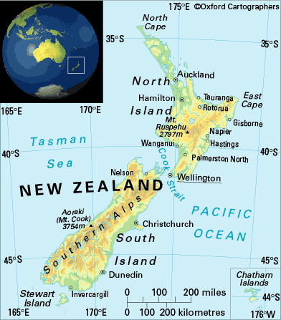

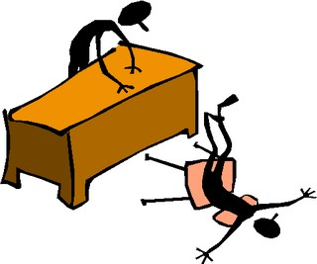

Introduction
Hmmm… Bill from the Plumber… I wonder what that job cost me…?
Argh!!! Are you SERIOUS?????????????

Slide 2
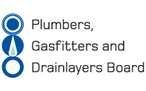
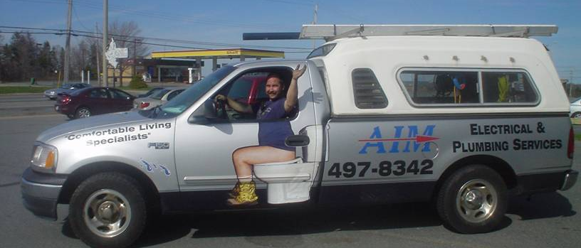
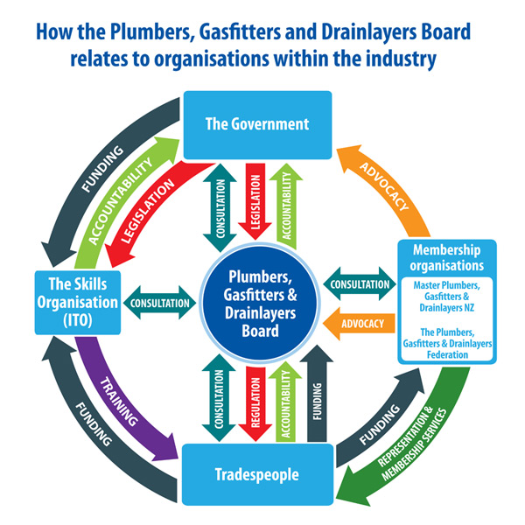



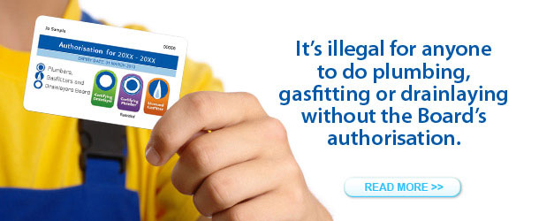
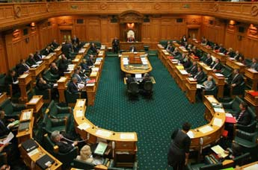
Who is there for the trades people in this industry?
Is the Plumbers, Gasfitters and Drainlayers Board (PGDB) really there for the Health and Safety of the public?
Why does the PGDB charge the practitioner so much?
Why are these fees and levies continuously rising?
Administers and Regulates –
“The Plumbers, Gasfitters and Drainlayers Act 2006”
Formerly –
“The Plumbers, Gasfitters and Drainlayers Act 1976”

Slide 3
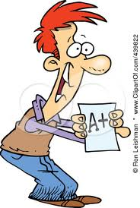

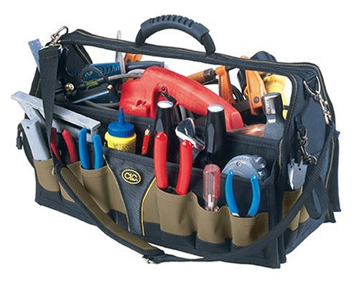

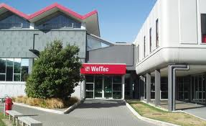

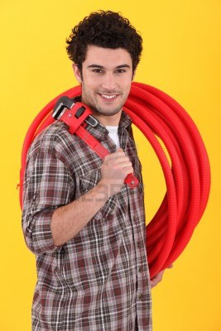
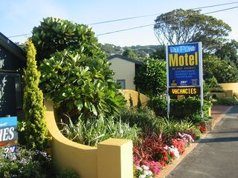

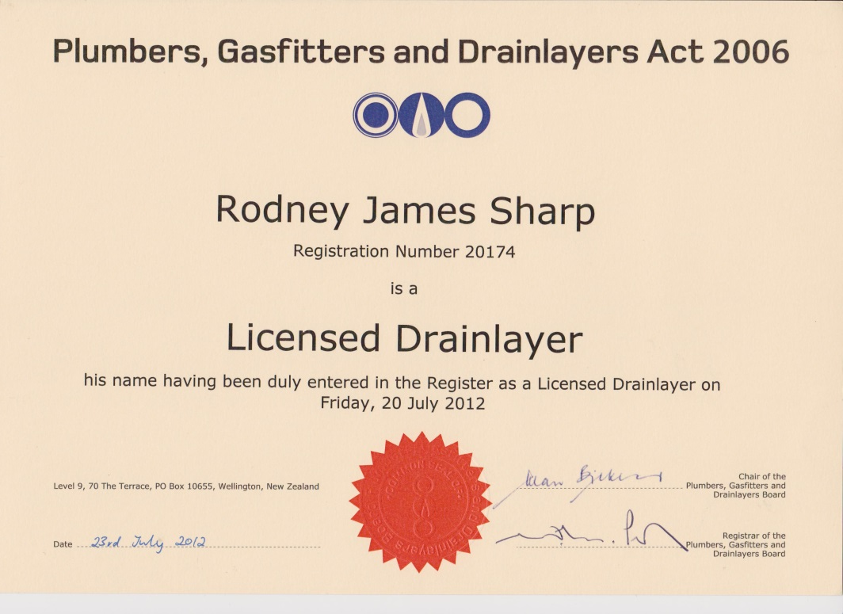
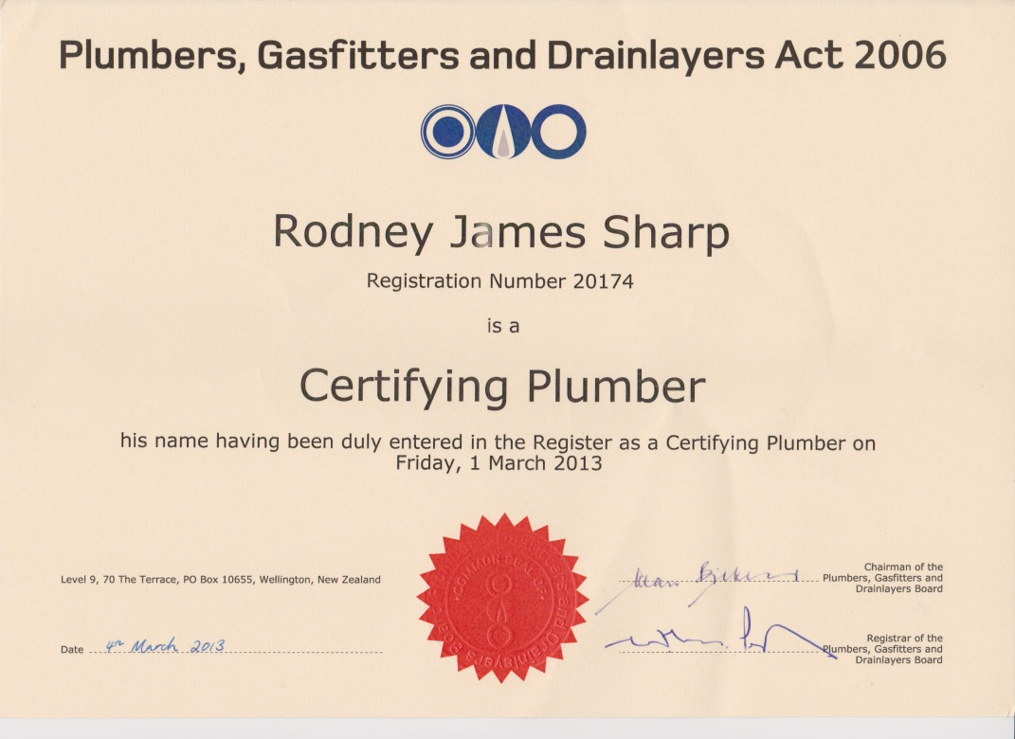




COSTS INVOLVED WITH TRAINING & APPRENTICESHIPS
Unit Standards - √ ☺
Exam - $411 per trade exam -√
FACTS:
Plumbing & Gasfitting apprenticeship = $ 10,580 increase from $6000
Drainlaying = Additional $3000
All three apprenticeships = $13,580
…Wahoo!! Can I go to work now?...
Codes - $ 710
Purchasing of tools
Travel & accomodation costs – block courses
Earning apprentice wages
WHAT ELSE???!!!
For Plumbers, Gasfitters & Drainlayers qualification to be recognised by the PDGB – they must…
Apply to be added to the register - $357 per trade
Purchase a Certificate - $51.00
NO!!!!!
$$$

Slide 4
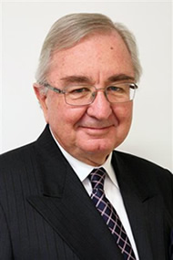
ONGOING COSTS ASSOCIATED WITH BEING QUALIFIED
ANNUAL FEES
ONE TRADE-
Licence - $101
Disciplinary & offences fee - $ 265
CPD - $ 360
Total = $726
PRACTISING LICENCE :
Uplift an annual practising licence - $101 per trade
Pay an annual one-off disciplinary & offences levy - $265 per tradesperson
TWO TRADES
Licence - $202
Disciplinary & offences fee - $ 265
CPD - $ 600
Total = $1067
CONDITIONS OF LICENSING:
CPD points – Continued Professional Development
It is ILLEGAL to work without a practising license, even if you are qualified and registered!!
CPD is a CONDITION of licensing!!
THREE TRADES
Licence - $303
Disciplinary & offences fee - $ 265
CPD - $ 720
THIS MEANS:
One trade/licence = $366 per year
Two trades/licences = $467 per year
Three trades/licenses = $568 per year
CPD COSTS:
One trade/license – 12 points = $360
Two trades/licences – 20 points = $600
Three trades/licences – 24 points = $720
Plumbers, Gasfitters & Drainlayers of NZ
THREE TRADES ANNUAL COSTS GRAND TOTAL –
$ 1288.00

Slide 5

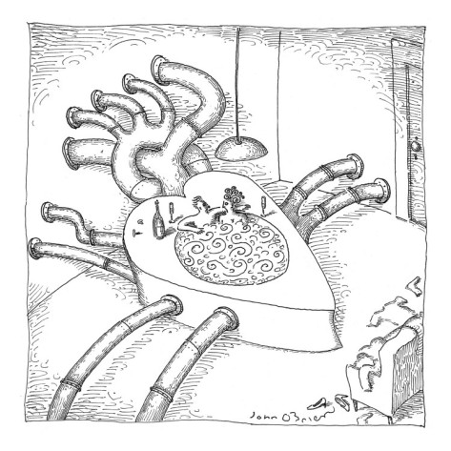
Registration $357.00
per trade (x3 is $1071)
Certificate $51.00
Licensing $101.00 per trade (x3 is $303)
Discipline $265.00
Examination $411.00 per exam (x3 is $1233)
Late Examination Application NIL – as late applications are not accepted
Trainee Limited Cert $45.00 per trade (x3 is $135)
CPD $360 (for 3 trades is $720)
Registration $434.45
Certificate $40.89
Licensing $729.20
Discipline $195.11
CPD mandatory with no charge
Registration $175.00
Certificate Free
Licensing $60.00
Discipline NIL (incl. in reg.)
Examination $85.00
Late Examination Application $85.00
Trainee Limited Cert NIL
CPD No fee

Slide 6
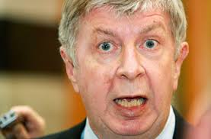
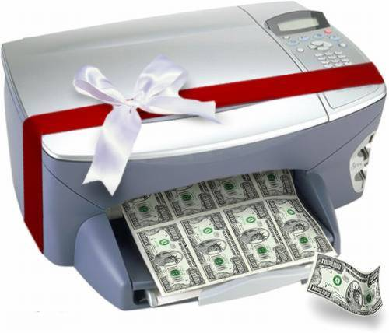
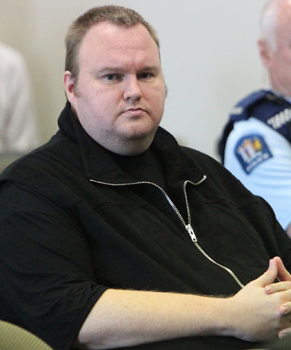
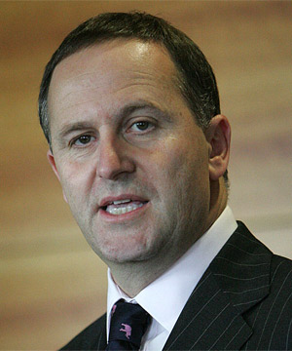
Guilty!!
AMENDMENT BILL
Owe the industry
$ 1,000,000.00
…ANY AMOUNT IT THINKS FIT!!...

Slide 7


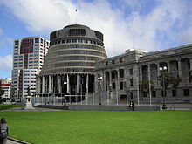
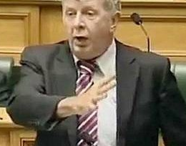


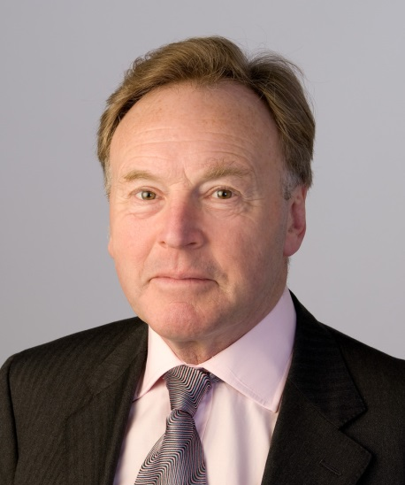
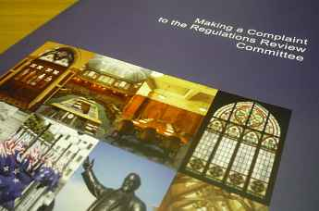
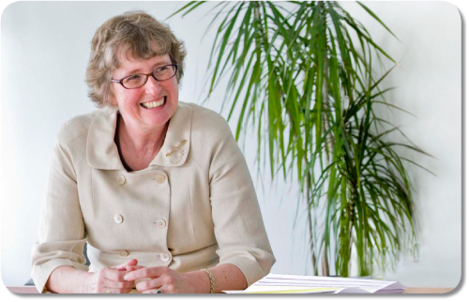




“The Board will become INSOLVENT!!!”
HAS OVER 1000 MEMBERS
VS

Slide 8

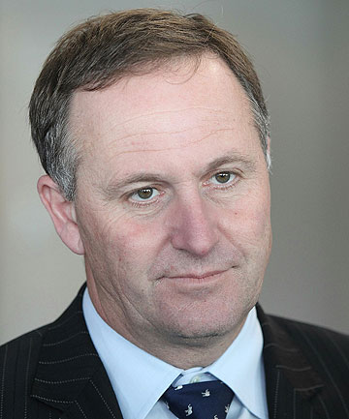

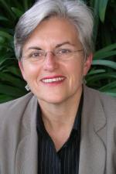
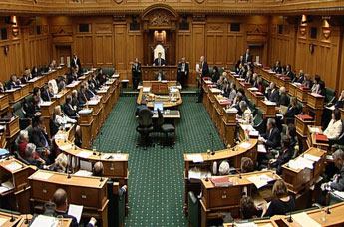

Where are your
CPD points???
…In The HOUSE…
…Explosion at Pizza Hutt…Caused by an ‘incompetent Gasfitter’
No! It was not a Pizza Hutt!...
It was a fish n chip shop!
“The Board” tried to pin the blame on a poor gasfitter…
They ruined his reputation; his business & he lost his home !! BUT…
This Gasfitter, was never found CULPABLE!!!!
“The Board” wasted $200,000 of practitioners money, pursuing the wrong man!!
Knowing full well who did it!!
Who may I ask are the incompetent one’s here????
√
Pfft!! In an ‘Ideal World’ perhaps…

Slide 9

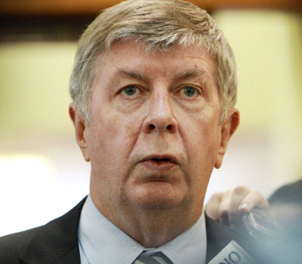

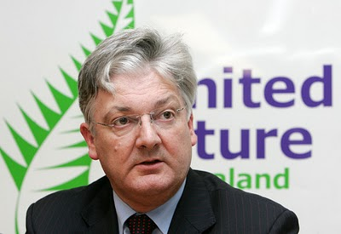





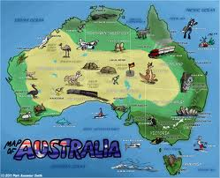
CONCLUSION
Who is there for the trades people in this industry?
A. Not the PGDB. Only the PGDF (Federation).
Is the Plumbers, Gasfitters and Drainlayers Board (PGDB) really there for the Health and Safety of the public?
A. No, they are not. It is the tradespeople who work in our homes, that protect our Health and Safety.
Why does the PDGB charge the practitioner so much?
A. Because they are greedy.
Why are these fees and levies continuously rising?
A. Because they have made an Industry within an Industry.
+
=
Opposed the Amendment Bill:
Labour, Greens, NZ First, Maori,
Mana & Independent MP
Brendon Horan.
Supported the Amendment Bill:
National, Act &United Future.
YOU and ME
- EDMUND BURKE -
- “ The only thing necessary for the triumph of evil; is for GOOD men to do NOTHING!!” -
Which brings the vote to 61 for and 60 against.

